Slide 1
Developed VTC Training Courses at GJU
Dr. Ziad Abu El-Rub Ms. Amira Aburabi German Jordanian University
Leipzig, Germany | 29 Sep. 2018 - 2 Oct. 2018

Slide 2
GJU Developed Training Materials
Aspen Plus Simulation
AutoCAD
Matlab
Principles of engineering economy

Slide 3
Aspen Plus Simulation
Training | Aspen plus V8.8
Beneficiary | Engineering students, mainly chemical & Pharmaceutical, energy, and others
Skills | Rigorous computer calculations of material and energy balances Equilibrium data for a process unit and/or a whole plant Sizing of unit operations
Trainers | Dr. Ziad Abuelrub Eng. Fahad Rumaneh
No. participants | 30 students
Frequency | Every semester (combined with planned design course )

Slide 4
Aspen Plus Simulation

Slide 5
AutoCAD
Training | AutoCAD
Beneficiary | Engineering students: e.g. Biomedical Engineering
Skills | AutoCAD is a CAD (Computer Aided Design or Computer Aided Drafting) software application for 2D and 3D design and drafting create mechanical and architectural drawings
Trainer(s) | Dr. Eyad Hamad
No. participants | 25 students
Frequency | every semester

Slide 6
MATLAB
Training | MATLAB
Beneficiary | Engineering students: e.g. Biomedical Engineering
Skills | deep learning and machine learning, signal processing and communications, image and video processing, control systems, test and measurement, computational finance, and computational biology. Analyze data Develop algorithms Create models and applications
Trainer(s) | Eng. Eslam al-Qasem
No. participants | 150 students
Frequency | every semester

Slide 7
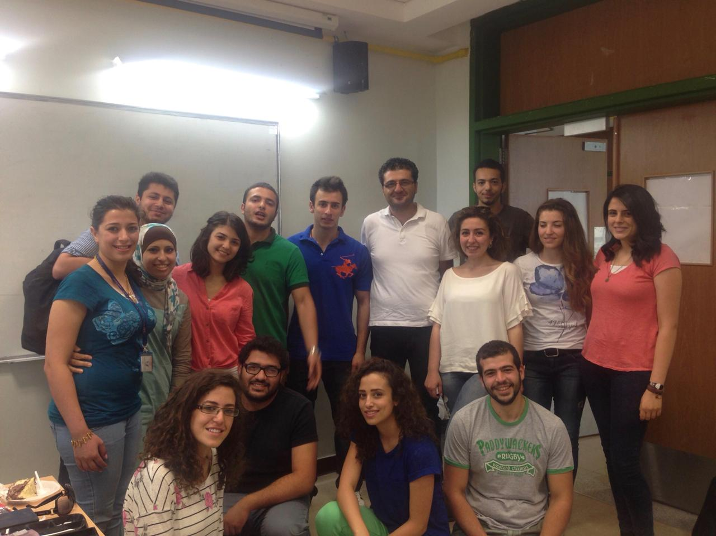
MATLAB

Slide 8
Introduction to Engineering Economy
Training | Introduction to Engineering Economy
Beneficiary | Engineering students: Pharmaceutical and chemical, biomedical, industrial, energy, mechanical…
Skills | systematic evaluation of the merits of proposed solutions to engineering problems
Trainer(s) | Dr. Ziad Abuelrub
No. participants | 12 students
Frequency | one week (May 2018)

Slide 9
Introduction to Engineering Economy

Slide 10
Thank you!

